Slide 1
Module 4 SALVAGE & GENERAL AVERAGE
Presented By
DR IRWIN OOI

Slide 2
SALVAGE

Slide 3
Salvage
What is a Salvage?
‘Brice on Maritime Law of Salvage, 4th Ed., 2003, Sweet and Maxwell at p.1, para.1-01
“[A] right to salvage arises when a person, acting as a volunteer (that is without any pre-existing contractual or legal duty to act) preserves or contributes to preserving at sea any vessel, cargo, freight or other recognised subject of salvage from danger”.

Slide 4
Salvage
SUBJECTS OF SALVAGE
Lord Esher MR in The Gas Float Whitton (No.2) [1896] P.42 (CA) – The only subjects where an Admiralty Court could entertain a salvage were a “ship, her apparel and cargo, including flotsam, jetsam, and lagan, and the wreck of these and freight; that the only subject added by statute is life salvage”.

Slide 5
Salvage
THE SHIP
Section 313(1) of the Merchant Shipping Act 1995:
“Ship” includes every description of vessel used in navigation.
Examples of subjects not capable of navigation:
A gas float, see The Gas Float Whitton (No.2) [1896] P.42

Slide 6
Salvage
THE SHIP
A jet ski, see Steedman v Schofield [1992] 2 Lloyd’s Rep.163
In practice, the salved value of stores is included in the salved value of the ship, see Brice on Maritime Law of Salvage, 4th Ed., 2003, Sweet and Maxwell at p.227, para.3-18
A hovercraft is also a ship, see section 1(1)(h)(ii) of the Hovercraft Act 1968.

Slide 7
Salvage
THE SHIP
Rendering salvage services to hovercraft are the doing so for ships, see Article 8 of the Hovercraft (Application of Enactments) Order 1972.

Slide 8
Salvage
THE SHIPS APPAREL
Never defined judicially.
Probably relates to property associated with a ship other than the hull, machinery, stores and cargo, e.g. navigational equipment, tackle, furnishings, life boats and the like, see Thomas, Maritime Liens, at pp.156-157, para.278

Slide 9
Salvage
CARGO
The courts adopt a broad and liberal interpretation of the word “cargo”, e.g. will be cover goods transported by a vessel through towage, although technically not inside the ship, see The Gas Float Whitton (No.2) [1897] A.C.337 per Lord Herschell at p.345

Slide 10
Salvage
CARGO
Also includes “flotsam”, “jetsam”, “ligan”, see Cargo ex Schiller (1877) 2 P.D.145 (CA) at p.148:
Flotsam, is when a ship is sunk or otherwise perished, and the goods float on the sea.
Jetsam, is when the ship is in danger of being sunk, and to lighten the ship the goods are cast into the sea, and afterwards, notwithstanding, the ship perish.

Slide 11
Salvage
CARGO
Lagan (vel potius ligan) is when the goods which are so cast into the sea, and afterwards the ship perishes, and such goods are so heavy that they sink to the bottom, and the mariners, to the intent to have them again, tie to them a buoy or cork, or such other thing that will not sink, so that they may find them again.

Slide 12
Salvage
BUNKERS
If owned by the shipowner, then it is usually included in the value of the ship as a matter of practice, see Brice on Maritime Law of Salvage, 4th Ed., 2003, Sweet and Maxwell at p.241, para.3-67
Bunkers in time chartered vessels are usually owned by the time charterer.

Slide 13
Salvage
BUNKERS
The shipowners are bailees of such bunkers, see The Span Terza [1984] 1 Lloyd’s Rep.119
As the time charterers are the owners of such bunkers and not the shipowner, it must be identified and valued separately, see Brice on Maritime Law of Salvage, 4th Ed., 2003, Sweet and Maxwell at p. 241, para.3-67

Slide 14
Salvage
FREIGHT
Remuneration payable for carriage of goods on a ship. It does not include “hire”, which is the sum payable for the use of a ship, see Brice on Maritime Law of Salvage, 4th Ed., 2003, Sweet and Maxwell at p.231, para.3-34
Freight must be at risk, so a salvage award could not be made for pre-paid freight, see Brice at p.232, para.3-35 to 3-38

Slide 15
CONDITIONS FOR CLAIMING A SALVAGE AWARD
Elements for Salvage under Common Law
(a) There is a recognized subject matter
Only maritime property can be salved. Defined as limited to ‘the ship, her apparel and cargo and …. the wreck of these and freight’ – The Gas Float Whitton [1897] AC 337

Slide 16
SALVAGE AWARD - CONDITIONS
VOLUNTARINESS
Master and crew salvaging their own vessel:
If the contract of employment of the master and crew with the shipowner are still intact, this requirement is not satisfied.
They are under a contractual duty, i.e. a pre-existing duty to save the ship, see The Neptune (1824) 1 Hagg Adm.227

Slide 17
SALVAGE AWARD - CONDITIONS
VOLUNTARINESS
No problem with voluntariness if the master and crew salve another vessel, i.e. one which they are not employed to sail on, see The Ocean Granduer [1972] 2 Lloyd’s Rep.396 (HC, Australia)

Slide 18
SALVAGE AWARD - CONDITIONS
VOLUNTARINESS
Passenger salving the ship, see Newman v Walters (1804) 3 Bos. & P.612
Ship abandoned by master and crew.
Pilot on board was too drunk.
A passenger who was a qualified master mariner was asked by the ship’s chief officer to take over.

Slide 19
SALVAGE AWARD - CONDITIONS
VOLUNTARINESS
The passenger could claim salvage as he voluntarily rendered his services.
Note: Usually, the need for self-preservation negates voluntariness.

Slide 20
SALVAGE AWARD - CONDITIONS
VOLUNTARINESS
Persons acting under a statutory duty (e.g. a pilot, harbour master and operators of port authority tugs)
See The Sandefjord [1953] 2 Lloyd’s Rep.557 (Pilot completed his duties and was waiting to disembark when called upon to help. He was acting voluntarily and not under a statutory duty)

Slide 21
SALVAGE AWARD - CONDITIONS
VOLUNTARINESS
See The Hudson Light [1970] 1 Lloyd’s Rep.166 (The ship dragged anchor and grounded. The tug boats enlisted the help of the pilot who directed the operation and re-floated the vessel on the flood tide. The requirement of voluntariness was satisfied as this was beyond what a pilot is expected to perform in the ordinary course of duties).

Slide 22
SALVAGE AWARD - CONDITIONS
VOLUNTARINESS
Cf: The Gregerso [1971] 1 Lloyd’s Rep.220 (Grounded vessel obstructed the entry / exit of the port. She was removed by the port authority tug under the direction of the harbour master. Voluntariness requirement not satisfied as they were acting under a statutory duty).

Slide 23
SALVAGE AWARD - CONDITIONS
VOLUNTARINESS
Cargo owners, see The Sava Star [1995] 2 Lloyd’s Rep.134 per Clarke J at p.141 (Decomposing cargo of fertiliser caused smoke and gas to escape from the holds. The cargo owner helped to formulate a crisis plan that included alerting a nearby fire brigade and a helicopter over-flight. The c/o also provided chemists, water carriers and thermocouplers. There is no authority to say that cargo owners are not volunteers).

Slide 24
SALVAGE AWARD - CONDITIONS
DANGER
The danger must be real, i.e. not imagined.
The test is an objective test because a person’s personal perception of danger may vary considerably, e.g. from not being afraid at all (see The San Demetrio (1941) 69 Lloyd’s Rep.5) to being timid (see The Albionic (1941) 70 Lloyd’s Rep.257)

Slide 25
SALVAGE AWARD - CONDITIONS
DANGER
See The Helenus and the Motagua [1982] 2 Lloyd’s Rep.261 per Sheen J – Elements of danger when the tow rope broke and the ship drifted:
Confined space near a wharf, potential damage to land structures and other ships in the area.
Strong winds (storm force)
Poor visibility (night)

Slide 26
SALVAGE AWARD - CONDITIONS
SUCCESS
Usually described as “no cure, no pay”, e.g. The Rene [1955] 1 Lloyd’s Rep.101 (The salvor worsened the situation by causing a collision)
Rationale for the rule: The property has to be saved, a valuation of the salved property made, and only then could a salvaged award be made.

Slide 27
SALVAGE AWARD - CONDITIONS
SUCCESS
Total success is not required, but there must be at least some success, see The Dart (1899) 8 Asp. MLC.481
But a mere attempt to salvage that does not contribute to success is not salvage, see The Zephyrus (1842) 166 E.R.596 per Dr. Lushington

Slide 28
SALVAGE AWARD - CONDITIONS
SUCCESS
Post success expenses, see The Winson [1982] A.C.939
After salvage has ended, the salvors may still be in possession of the ship as bailees.
Services are rendered to preserve the ship for the benefit for the shipowner.
This sum is recoverable over and above the salvage award.

Slide 29
SALVED VALUES
Brandon J in The Lyrma (No.2) [1978] 2 Lloyd’s Rep.30 at p.33:
A salvage award will never amount to the whole value of the salved property.
The value will be assessed as the time and place of the termination of salvage services.

Slide 30
SALVED VALUES
Value of a salved ship, see The Clyde (1856) Swa.23 (Market value of the ship prior to a collision).
Depreciation in value when the services are terminated and when the ship is sold, i.e. salvage remuneration will be greater than the fund available in court after the sale of the ship, see The Pampa (1925) 22 Lloyd’s Rep.496 per Brandon J

Slide 31
Salvage AWARD
Factors suggest by Sheen J in The Rilland [1979] 1 Lloyd’s Rep.455 to be taken into account in determining the salvage award (borrowing heavily from Sir John Nicoll in The Industry (1835) 3 Hag. Adm.203):
Salvage value of the ship or other property saved.
Measure of success.

Slide 32
Salvage AWARD
Skill and effort of the salvors.
Time occupied in performing the service.
Risk undertaken by the salvors, i.e. also includes the liabilities they might be exposed to.
Promptness of the service.
The vessels and equipment used in the operation.

Slide 33
Salvage AWARD
State of readiness and efficiency.
Efforts expanded in preventing or minimising damage to the environment.
Note: These factors are now found in the 1989 Salvage Convention.

Slide 34
APPORTIONMENT OF THE SALVAGE AWARD
See The Golden Falcon [1990] 2 Lloyd’s Rep.366 (Supreme Court, NSW, Australia) per Carruthers J at p.372 and p.376:
There are no firm rules on apportionment, i.e. it depends on the fact of each case.
The master usually receives proportionally more than the crew, not because he holds a certificate, but because of his actual contribution.

Slide 35
APPORTIONMENT OF THE SALVAGE AWARD
There is no rule in English law that after the deduction of the owner’s portion, the master’s share is 1/3 of the balance.
The balance may be subdivided among the crew according to their rating.
On the facts of the case, the s/o was awarded 82% and the remaining 18% was to be distributed among master and crew.

Slide 36
APPORTIONMENT OF THE SALVAGE AWARD
Apportionment among the crew is done on the basis of their basic pay, because bonuses may be paid at a flat rate regardless of rank or status, see The Empire Gulf (1948) 81 Lloyd’s Rep.255

Slide 37
NEGLIGENCE AND THE SALVOR
Can a tortfeasor be a salvor? See The Beaverford v The Kafiristan [1938] A.C.136 (HL)
Collision between two vessels.
The ship that was not badly damaged rendered salvage by standing by.
The rendering of salvage services are distinct and not connected with the negligent navigation that caused the collision.

Slide 38
NEGLIGENCE AND THE SALVOR
How to factor in the negligence into the salvage award? See The Tojo Maru [1971] 1 Lloyd’s Rep.341 (HL) (Explosion caused by a diver employed by the salvors firing a bolt through the shell plating):
Step 1 – Determine the salved value of the ship if there had been no negligence. The salvage remuneration should be based on this, taking no account of the damage done by the salvors.

Slide 39
NEGLIGENCE AND THE SALVOR
Step 2 – Determine the actual value of the ship, as affected by the negligence of the salvors, when salvage services were terminated.
Step 3 – If the amount in (2) above is greater than the amount in (1), then there would be a set-off, and the salvors would pay the net balance.

Slide 40
SALVAGE STANDARD FORM AGREEMENTS
Lloyd’s Open Form, e.g. LOF 80, LOF 90, LOF 95 and LOF 2000. Formulated in the late 1800s and based on the “no cure, no pay” principle.
The master of a vessel in distress has ostensible authority to sign these contracts under the doctrine of agency of necessity, see The Unique Mariner [1978] 1 Lloyd’s Rep.438 per Brandon J at p.449 and The Choko Star [1990] 1 Lloyd’s Rep.516 (CA)

Slide 41
SALVAGE STANDARD FORM AGREEMENTS
LOF 80
Provides an exception to the “no cure, no pay” principle where salvage is rendered to a tanker is not successful.
Salvors expenses covered, plus increment not exceeding 15% of such expenses.
Provides an incentive to save tankers, although chances of success might be small.

Slide 42
SALVAGE STANDARD FORM AGREEMENTS
LOF 90 (Drafted to take into consideration provisions of the 1989 Salvage Convention).
LOF 95 (Incorporates English Law, as the 1989 Salvage Convention had now been made a part of English Law via statute, see Schedule 11 of the MSA 1995).

Slide 43
SALVAGE STANDARD FORM AGREEMENTS
Prevention of damage to the environment and The Nagasaki Spirit [1997] 1 Lloyd’s Rep.323
No element of profit in “fair rate” in Article 14(3) of the 1989 Salvage Convention.
The salvors had to prove that there was a threat to the environment)

Slide 44
LOF 2011
Transparency, see Clause 3. Exception in Clause 12 of Lloyd’s Standard Salvage and Arbitration Clauses (LSSA) and Procedural Rules:
Appeal against the award, OR
Application to withhold publication of the award,

Slide 45
LOF 2011
Salvors’ Notification to Council of Lloyd’s within 14 days of , see Clause 4.
Security for fees of arbitrator and appeal arbitrators, see Clause 6.6 and Clause 10.8 of LSSA.
For containerised cargo, sufficient notice to those putting up security, see Clause 13 of the LSSA.

Slide 46
LOF 2011
Unrepresented cargo interests, subject to decision of arbitrator if agreement can be reached with 75 of salved value of cargo, see Clause 14 of the LSSA.
Exclusion of low value cargoes as cost of security is much higher than value of the salved SM, see Clause 15 of the LSSA.

Slide 47
ORIGINAL SCOPIC CLAUSE
Special Compensation P & I Club Clause.
Used in conjunction with LOF 95.
Salvors are relieved from the need to prove a threat to the environment.
Within two working days of the salvors invoking this, s/o must furnish security of US $3 million (Can be increased or reduced accordingly later).

Slide 48
ORIGINAL SCOPIC CLAUSE
The 30% uplift may may go to a max 100% under Article 14, is fixed by a percentage of 25%
SCOPIC does not interfere with the factors listed in Article 13 that are still used as a basis for assessing the award.

Slide 49
SCOPIC 2014
ISU 5 Guarantee Form – USD3 million security payable by s/o (or its insurers) within 2 working days of SCOPIC clause being invoked.
New Appendix A for new level of agreed tariff of daily hire rates for equipment and personnel.

Slide 50
SCOPIC 2014
From 01 January 2014, SCOPIC rate is at 6.78 percent on all items.
From 1 January 2017, the rate increased by 2 percent (in accordance with US Consumer Price Index).
Special Casualty Representative (SCR) – observe and report on salvage process.

Slide 51
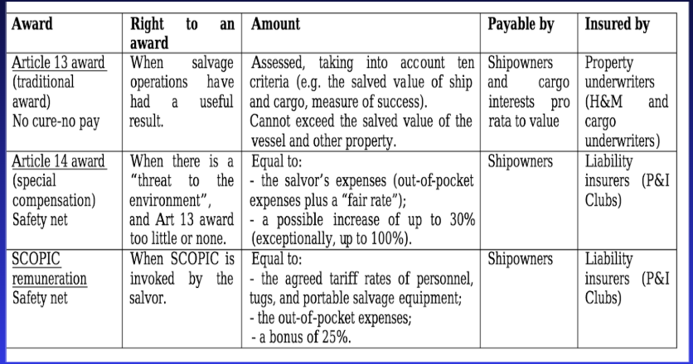
SCOPIC 2014

Slide 52
SCOPIC 2014
From 01 January 2014, SCOPIC rate is at 6.78 percent on all items.
From 1 January 2017, the rate increased by 2 percent (in accordance with US Consumer Price Index).
Special Casualty Representative (SCR) – observe and report on salvage process.

Slide 53
GENERAL AVERAGE

Slide 54
GENERAL AVERAGE
WHAT IS GENERAL AVERAGE?
Sui generis.
Distribution of risks.
Equitable sharing.
Common maritime adventure.
No party benefitting from misfortune

Slide 55
GENERAL AVERAGE
CONCEPT AND LEGAL FRAMEWORK
York Antwerp Rules.
Extraordinary sacrifice / expenditure
Intentionally and reasonable made
Incurred for common safety
Preservation of property in a common maritime adventure from peril
Shared rateably.
No proof of liability needed.

Slide 56
GENERAL AVERAGE
CONCEPT AND LEGAL FRAMEWORK
Exception to contribution, see Strange v Scott (1889) 14 App Cas 601:
Party who’s fault / negligence caused the peril.
Improper deck stowage.

Slide 57
GENERAL AVERAGE
THE YORK ANTWERP RULES
Harmonisation of GA practice.
Latest version 2016.
Most popular, arguably 1994.
First part – general, alphabets.
Second part – specific, Roman numerals.
Voluntary.
If GA rules silent / absence of agreement, law where adventure ends governs the contract, see Simonds v White (1824) 2 B & C.805

Slide 58
GENERAL AVERAGE
DANGER / PERIL TO THE COMMON ADVENTURER
Affect entire adventure, specific interest insufficient, see Nesbitt v Lushington (1792) 4 TR 783 (Some corn lost to ‘piracy’, some lost to ‘perils of the seas’).
Actual / real danger – ‘Imaginary’ danger insufficient, even reasonable belief insufficient, see Joseph Watson v Fireman’s Fund [1922] 2 KB 355 (Mistaken idea ship / cargo was on fire due to some smoke. No evidence of fire found).

Slide 59
GENERAL AVERAGE
EXTRAORDINARY EXPENDITURE / SACRIFICE
Previously thought that GA sacrifice or expenditure must go beyond the contractual duties.
More recent approach - No rigid rule that expenditure cannot qualify for GA merely because the shipowner was contractually obliged to incur it, see The Longchamp [2015] 1 Lloyd’s Rep.76 at para.66 per Stephen Hoffmayer QC’s view of The Bijela [1993] 1 Lloyd’s Rep.411. In the Supreme Court in The Longchamp [2017] UKSC 68, Lord Neuberger and the majority agreed that this was expenses legitimately incurred during the negotiation period with pirates.
Much depends on the facts of each case.

Slide 60
GENERAL AVERAGE
EXAMPLES OF EXPENDITURE
Rule F – ‘Additional expenses’ not typically GA but which replaces expenses that are normally GA.
Rule X – Expenses in saving the ship from loss / damage, e.g. lightening vessel, towage services, salvage services. Plus cost of minimising environmental damage.
Rule XI – Expenses incurred for wages of master / crew at port of refuge.

Slide 61
GENERAL AVERAGE
EXAMPLES OF EXPENDITURE
Rule X and Rule XI – Port of refuge expenses.
Rule XIV – Expenses for repair.

Slide 62
GENERAL AVERAGE
EXAMPLES OF SACRIFICE
Cargo
Jettison (Rule I)
Burning of cargo as fuel, see Robinson v Price (1877) 2 QBD 295
Loss from extinguishing a fire onboard (Rule III)
Depreciation of value of cargo (even if physically undamaged), see Anglo-Argentine Live Stock Agency v Temperly SS Co [1899] 2 QB 403

Slide 63
GENERAL AVERAGE
EXAMPLES OF SACRIFICE
Ship
Damage to machinery and boilers when ship runs aground (Rule VIII)
Burning of ship’s material as fuel (Rule IX)
Voluntary stranding (Rule V)

Slide 64
GENERAL AVERAGE
VOLUNTARILY / INTENTIONALLY & REASONABLY MADE
Sole purpose must be preservation / protection of interests exposed to danger, see Athel Line Ltd v Liverpool War Risk Insurance Association Ltd [1994] KB 87 at p 94.
Reasonableness can be judged by reference to pressure / time constraints faced by the master, see The Longchamp (supra) (bunker costs, media response, telephone calls and cost of negotiations to release vessel from pirates were reasonable).

Slide 65
GENERAL AVERAGE
PRESERVATION OF PROPERTY IMPERILLED
Success in saving property (e.g. ship, bunker, goods and freight) mandatory.
No GA if entire venture is lost, see Pirie Co v Middle Dock Co (1881) 44 LT 426

Slide 66
GENERAL AVERAGE
TIME BAR
Rule XXIII
1 year from date of GA adjustment was issued.
Extension only if parties agree.

Slide 67
GENERAL AVERAGE
ADJUSTMENT PROCEDURE
Shipowner makes GA declaration. Burden of proving loss / expense is allowed.
Party making the contribution / sacrifice gives notice of claim to GA adjuster.
Within 12 months when common adventure came to an end, see Rule E.
GA makes estimate based on available evidence if no notice received.

Slide 68
GENERAL AVERAGE
ADJUSTMENT PROCEDURE
In no express clause to the contrary, GA adjusted based on (local) laws at place where common adventure terminates, see Rule G.
Calculation made on: Value of sacrificed property, and Contributory Values
Based on value at date of discharge at port of destination, OR
Date at which the voyage was interrupted.

Slide 69
GENERAL AVERAGE - DOCUMENTATION
Docs and info from port of refuge:
Log extracts
Survey reports
Details of repair
Daily maintenance rates
Shifting of cargo
Docs from a ship on fire:
Survey report on extent of fire and extinguishment process
Accounts for repair, and fire-fighting costs

Slide 70
GENERAL AVERAGE - DOCUMENTATION
Docs where ship runs aground:
Survey report: Damage caused by grounding, and damage cause by refloating
Accounts for repair and lighterage.
Copy of towage / salvage contracts (if any).
Docs relating to the cargo:
Bill of lading (full copy)
Cargo manifest (at time of casualty)
Out-Turn cargo details (i.e cargo delivered)
Security docs, or deposit recepits

Slide 71
GENERAL AVERAGE - SECURITY
Consultation with GA Adjuster.
Size of GA claim is an important factor.
Shipowner advised on how to proceed.
Security normally in Lloyd’s Form Average Bond, together with:
Cash deposits, OR
Satisfactory guarantees by underwriters (in lieu of the deposits)

Slide 72
GENERAL AVERAGE - SECURITY
Consultation with GA Adjuster.
Size of GA claim is an important factor.
Shipowner advised on how to proceed.
Security normally in Lloyd’s Form Average Bond, together with:
Cash deposits, OR
Satisfactory guarantees by underwriters (in lieu of the deposits)

Slide 73
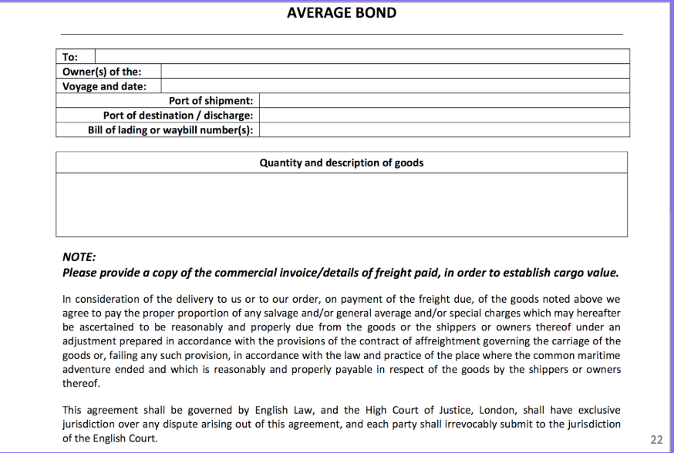
GA BOND SAMPLE

Slide 74
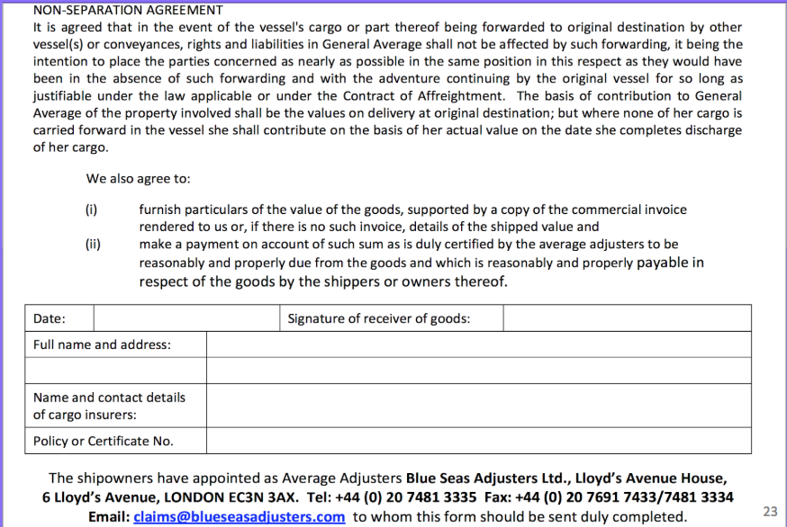
GA BOND SAMPLE

Slide 75
GENERAL AVERAGE - SECURITY
Shipowner releases the cargo after getting security guarantees.
Loss of possessory lien over the cargo.
If security is not forthcoming, shipowner has lien to hold all goods on board to secure proportion of GA by each cargo owner, see The Lehmann Timber [2013] 2 Lloyd’s Rep.541 (reasonable for shipowner to insist on an average bond from cargo interest even though their own insurers had provided a guarantee).

Slide 76
GENERAL AVERAGE – GA IN THE ADMIRALTY COURT
Section 24(b) of the Court of Judicature Act 1964
Sections 20 to 24 of the Supreme Courts Act 1981
In rem action for GA claims under Section 20(2).

Slide 77
Problem question on general average and salvage

Slide 78
The adventures of the m.v. wancheek 5,000 teu container vessel

Slide 79
1 July 2018
Starts plying the liner route between Port of Tanjung Pelepas and Port of Shanghai.
2713 nm, approx 7.1 sailing days at 16 knots.
Severe weather warning off the east coast of Taiwan.

Slide 80
3 july 2018 - morning
Encounters severe gale, Force 9 on Beaufort Scale.
Wind speed 47 knots.
32 ft waves.
Ship suffers some minor structural damage.

Slide 81
3 july 2018 - evening
Escalation to a storm, Force 10 on Beaufort Scale.
Wind speed 55 knots.
41 ft waves.
Ship suffers even more damage.

Slide 82
4 july 2018 - morning
Rapid escalation to Force 12 on Beaufort Scale, Hurricane Force.
Wind speed at 65 knots.
Ship starts to experience stability problems.

Slide 83
4 july 2018 - evening
The ship passes through the hurricane.
Captain Gong makes decision to sail to Port of Kaohsiung for repairs.

Slide 84
5 july 2018 - morning
The M.V. Wancheek arrives at Port of Kaohsiung.
Ship repaired at the yard or Donny Chang Marine Services Ltd, which has its registered business at Kusan District, Taiwan.

Slide 85
9 july 2018 - 0900
Arrival outside administrative district of Port of Shanghai.
Unable to enter port due to congestion at berths.
Ship anchors 10 nm outside the port limits and waits for its turn to berth.

Slide 86
9 july 2018 - 1300
The ship starts listing a little. Ballasting does not improve the situation.
Captain Gong orders for some containers (50 One TEU containers) to be jettisoned.
No lighters available from the port.
The listing of the ship does not get any worse.

Slide 87
9 july 2018 - 1530
Mr Fei Xing Yuan (FXY), a pilot with the Shanghai Maritime Pilots Association arrives.
FXY is the pilot that has been hired by the ship to help navigate the ship in.
FXY tells Captain Gong that he will stand by to monitor the situation.

Slide 88
9 july 2018 - 1630
Ship starts to list again.
Captain Gong is unable to determine the reason why this is so.
Rate of listing accelerates.
More containers are jettisoned (50 One TEU containers).
Captain Gong radios for help (from salvors).

Slide 89
9 july 2018 - 1730
None of the containers have sunk.
There are now almost 100 containers floating around the M.V. Wancheek.
Expected to remain floating for the next 1.5 months at least.
The listing has stopped.

Slide 90
9 july 2018 - 1800
Salvors arrive, i.e. Port of Shanghai Salvage Co (PSSC).
Contract signed for LOF 2011, incorporating additional clauses which are in pari materia with SCOPIC 2014 (including 2017 rates).
Salvage process commences.

Slide 91
11 july 2018 - 1200
Salvors claim 10 percent of the value of the M.V. Wancheek (market value at USD35 million).
Salvors have also claimed a sum (as yet undetermined) for saving the environment (i.e. floating containers are a hazard).

Slide 92
11 july 2018 - 1200
Mr FXY and the crew (and master) of the M.V. Wancheek, have also claimed as sum for salvage.

Slide 93
-end-
Presented By
DR IRWIN OOI

